Slide 1

CMPT 606
Indexing
Read Chapter 17

Slide 2



Outline
Introduction
Tree Based Indexes
Hash Indexes (covered in next lecture)
Notes:
Types of index
Clustered vs. Unclustered
Dense vs. Sparse
Data Structures
Hash based indexing
Tree based indexing
set statistics io on
SQL - 8K pages
exec sp_helpindex tableName

Slide 3

Introduction to Indexes

Slide 4

DB Internals – Journey so far…
Access Methods support the DBMS's execution engine to speed-up read/write data from pages.
Two types of data structures:
Trees
Hash Tables
Notes:
Data Organization
→How we layout data structure in memory/pages and what information to store to support efficient access.

Slide 5
Types of Queries
Point Query SELECT balance FROM accounts WHERE number = 1023;
Multipoint Query SELECT balance FROM accounts WHERE branchNo = 100;
Ordering Query SELECT * FROM accounts ORDER BY balance;
Range Query SELECT number FROM accounts WHERE balance > 10000 and balance <= 20000;
Prefix Match Query SELECT * FROM employees WHERE name like ‘J*’ ;

Slide 6
Types of Queries
Scan Query
SELECT avg(salary) FROM employees;
Extremal Query
SELECT * FROM accounts WHERE balance = max(select balance from accounts);
Grouping Query SELECT branchNo, avg(balance) FROM accounts GROUP BY branchNo;
Join Query SELECT distinct b.branchName FROM accounts a join branch on a.branchNo = b.branchNo WHERE a.balance > 10000;

Slide 7

Index
An index is a data structure that supports efficient access to data
Set of Records
Condition on attribute value
Matching records
index
(search key)
Think about the relative ease of finding a topic in a book by using the index, rather than by reading through the book from start to finish!

Slide 8
Indexes
An index is a data structure that organizes data to optimize locating row(s) without having to scan entire table
An index supports efficient retrieval of records based on the search key of the index
A table can have more than one index – each based on a different search key
An index is a collection of data entries which must contain:
A search key value, k, and
Pointer to find data records with that search key value
Notes:
An index can be created for a file to speed up searches that are not efficiently supported by the file's organization
Index entries are stored in accordance with the search key value
Files can be indexed, to provide multiple ways to access records efficiently
Index files contain search key values and pointers to find data records with that search key value
•Mechanism for efficiently locating row(s) without having to scan entire table
•Based on a search key: rows having a particular value for the search key attributes can be quickly located

Slide 9
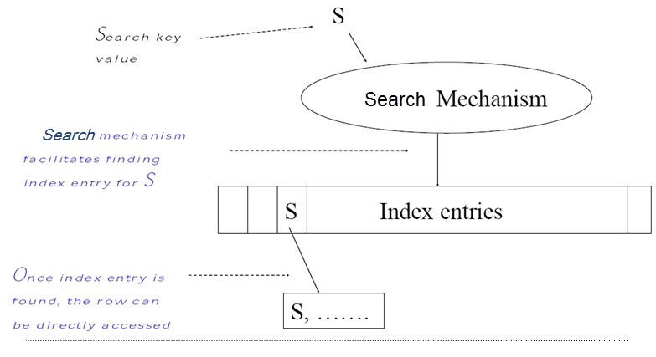
Index Structure
Notes:
–Index entries contains:
•Can contain the data tuple itself (index and table are integrated in this case) –clustered index - or
•Search key value and a pointer to a row having that value; table stored separately in this case –unclustered index
–Search mechanism
•Algorithm + data structure for locating an index entry with a given search key value
–Index entries are stored in accordance with the search key value
•Entries with the same search key value are stored together (hash, B-tree)
•Entries may be sorted on search key value (B-tree)

Slide 10
Indexes Trade-off
Two important considerations when creating an index:
The tradeoff between the computational gain from using the index and the computational cost of maintaining it when the table data is altered by an operation such as insert, update, or delete.
+ Additional I/O to access index pages (except if the index is small enough to fit in main memory)
The extra disk space that the index structure requires
=> Longer to backup and restore
Only create an index when the performance gain from having it outweighs the cost of storing/maintaining it
Notes:
There is a trade-off on the number of indexes to create per table.
Indexes take-up disk space
Index must be updated when table is modified.
Because each index needs to be maintained when the table is modified by an insert, delete, or update - and because index structures consume additional disk space - an index is created only when there is reason to believe that the performance gain from having it outweighs the cost of storing/maintaining it.

Slide 11
Clustered Index
Clustering Index = the actual data are stored in the order dictated by the index. In a non-clustering index, it is not.
It can defined on a Primary key or on a non-key field
Often implemented as a B-Tree data structure
Leaf nodes contain the data pages of the underlying table
There can only be one clustered index for a table
Clustered Index is good for range searches, ORDER BY or GROUP BY queries
The index is only used to locate the first row in the range, and then subsequent rows are found by following the physical order of the data
E.g., CSE courses in QU catalog – lookup the index to locate the first page of CSE courses, then continue reading all the descriptions without needing to refer to the index again
Notes:
It can defined on a key or on a non-key field
Index defined on a key field is called a primary index
http://questpond.over-blog.com/article-sql-server-interview-questions-can-you-explain-clustered-index-and-non-clustered-index-97444471.html
Index defined on a key field is called a primary index
Also called a Primary index? (I guess if defined on a primary key).
Clustered indexes can be either dense or sparse
Use location mechanism to locate index entry at start of range. This locates first row.
Subsequent rows are stored in successive locations (not so for unclustered index)
Minimizes page transfers and maximizes likelihood of cache hits
an index specified on the Sort key field of a sorted file of records.
An index on a sequential file
The search key of the index is the same as the sort key of the file
when a range of search key values is requested.
Primary indexes are also referred to as clustered
Clustered Index
Only one per table
Faster to read than non clustered as data is physically stored in index order
Non Clustered Index
Can have many per table
Quicker for insert and update operations than a clustered index
Both types of index will improve performance when select data with fields that use the index but will slow down update and insert operations.
Because of the slower insert and update clustered indexes should be set on a field that is normally incremental i.e. Id or Timestamp.
Good comparison @ http://sql-plsql.blogspot.in/2010/06/non-clustered-indexes.html

Slide 12
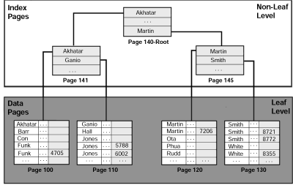
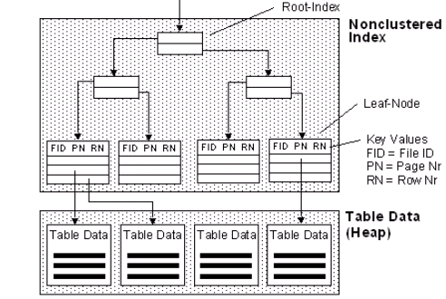
Clustered vs. Non-Clustered Index
Clustered Index
Non-Clustered Index
Or Clustered Index
Leaf pages store the actual data in order dictated by the index
Can only be one clustered index for a table
Leaf pages store pointers to records
There might be several non-clustered indexes per table
Notes:
Clustered indices tend to be more expensive to Maintain
Unclustered index = the actual data are not stored in the order dictated by the index
Sometimes referred to as secondary index
Secondary indexes must be dense
The pointers of a secondary indexes may point to many blocks of the data file
Making secondary indexes less efficient than primary indexes
Heap (data) files are not ordered so require secondary indexes
A primary index = an index where the search key includes the primary key
A clustered index on attribute X co-locates records whose X values are near to one another.
Clustered index
data rows of the underlying table are sorted and stored in order dictated by the index
can only be one clustered index for a table

Slide 13
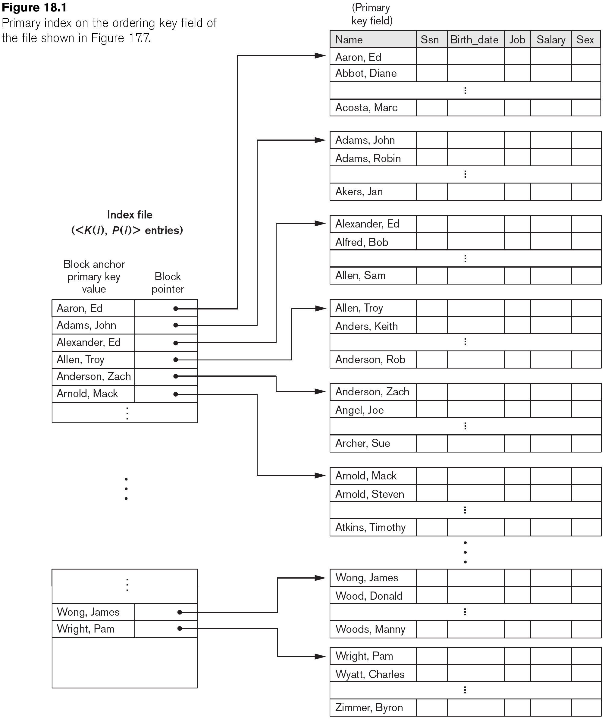
Clustered Index on the Primary Key field
Sparse Index containing <KeyValue : Pointer to Block>
One index entry for each data block
Notes:
Choose small key when creating an index

Slide 14
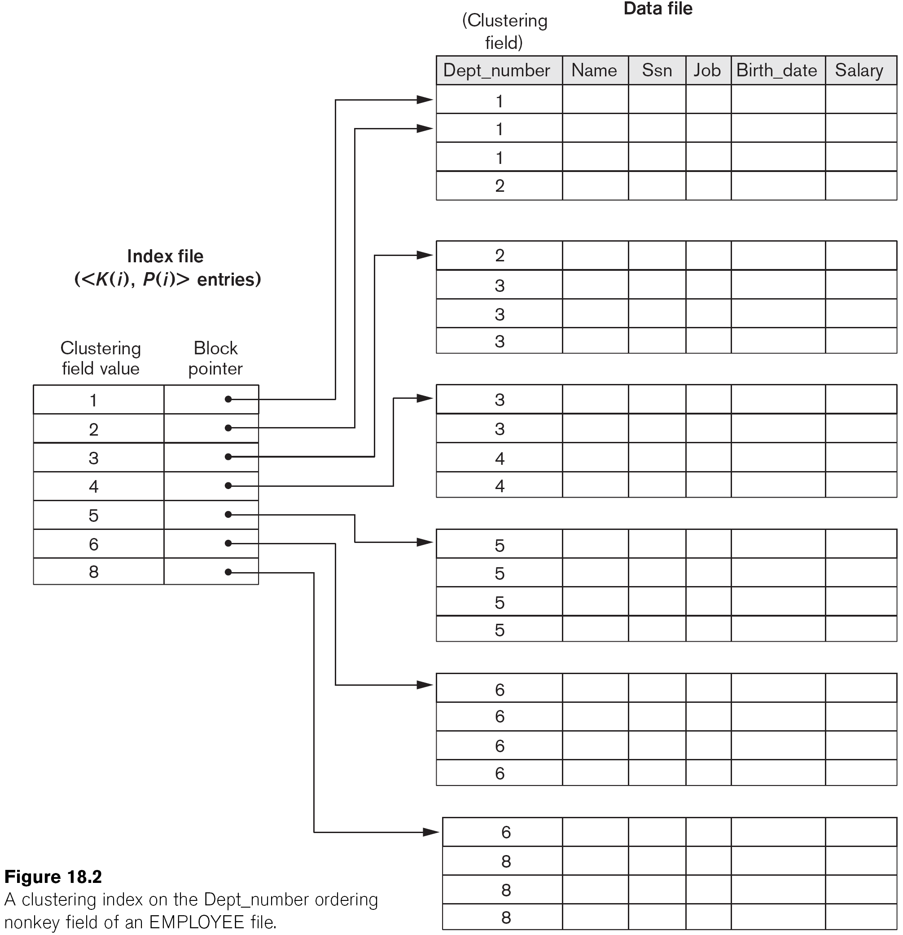
A Clustered Index on non-key field
Sparse Index containing <KeyValue : Pointer to Block>
One index entry for each distinct value of the search key

Slide 15
Dense vs. Sparse Index
Sparse index
Pointers are associated to Blocks
index contain <KeyValue : pointer to block>. One index entry for each data block
Only a clustering index can be sparse
The index is searched for the largest key less than or equal to the desired value
The pointer is then followed to a block of the data file
Dense index
Index contain < KeyValue: pointer to record>. Pointers are associated to records
Non clustered indexes are dense: one entry for each distinct value of the search key
B₁
B₂
B_{i}
record
record
record
Notes:
A dense index contain <search key : pointer to record> pairs
Pointers are addresses to the records with the search key
The blocks of the index are in the same order as the file
Searching an index is faster than searching the file
The index is smaller than the file
The index is sorted so binary search can be used
The index may be small enough to fit in main memory
If so records can be found with one disk I/O
Sparse:
A sparse index usually contains one data entry for each block of records in a data file
It is only possible to use a sparse index if the data file is sorted by the search key of the index
Sparse indexes are usually smaller than dense indexes
Sparse indexes are searched in much the same way as dense indexes
Except that the index is searched for the largest key less than or equal to the target value
The pointer is then followed to a block of the data file

Slide 16
Dense vs. Sparse Indexes
Ashby, 25, 3000
Basu, 33, 4003
22
Bristow, 30, 2007
25
Ashby
30
Cass
Cass, 50, 5004
33
Smith
Daniels, 22, 6003
Jones, 40, 6003
40
44
Smith, 44, 3000
44
Tracy, 44, 5004
50
Sparse Index
Dense Index
on
Data File
on
Name
Age
Notes:
Every sparse index is clustered!

Slide 17
Covering Index
A covering index is an index that contains all the columns you need for a query.
SELECT * FROM tablename WHERE criteria
will typically use indexes to speed up the resolution of which rows to retrieve using criteria, but then it will go to the data file to retrieve the rows.
However, if the index contained the columns column1, column2 and column3, then this query:
SELECT column1, column2 FROM tablename WHERE criteria
Could be answered from the index only. The index will be used to speed up the resolution of which rows to retrieve, also it already contains the values of the requested columns
So it won't have to go to the data file to retrieve the rows, but can produce the results directly from the index.
Notes:
Index Include Columns: Embed additional columns in index to support index-only queries.
An index’s search key can contain several fields
Such search keys are referred to as composite search keys or concatenated keys
e.g. {fName, lName}
For searches on equality the values for each field in the search key must match the values in record
e.g. 'Joe Smith' does not match 'Joe Jones' or 'Fred Smith'
For range queries, ranges may be specified for any fields in the search key.
If no values are specified for a field it implies that any value is acceptable for that field

Slide 18
Tree Based Indexes
Notes:
https://www.cs.usfca.edu/~galles/visualization/BPlusTree.html
In a B-tree, pointers to data records exist at all levels of the tree
In a B+-tree, all pointers to data records exists at the leaf-level nodes
A B+-tree can have less levels (or higher capacity of search values) than the corresponding B-tree

Slide 19
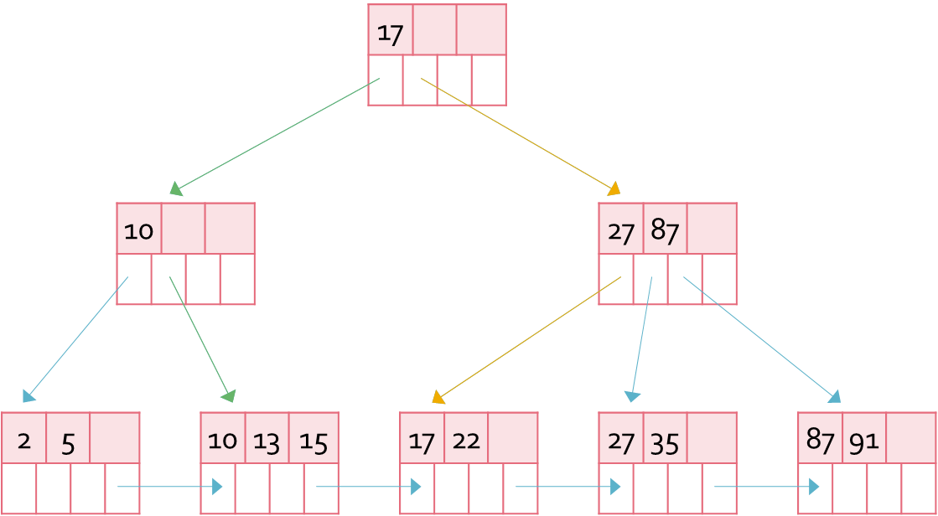
Full Table Scan vs. Index Access
Sequential Scan
vs. Index Seek
2 | 10 | 5 | 15 | 13 | 22 | 17 | 91 | 35 | 87 | 27

Slide 20
Single Level Indexes
``Find all students with gpa > 3.0’’
If data is in sorted file, do binary search to find first such student, then scan to find others.
Average cost of binary search O(log n)
Simple idea: Create an `index’ file.
k1
k2
kN
Index File
Page 1
Page 2
Page 3
Page N
Data File
Can do binary search on (smaller) index file!
Notes:
3
Jump to middle key, pivot left/right depending on comparison.
https://hackernoon.com/what-does-the-time-complexity-o-log-n-actually-mean-45f94bb5bfbf

Slide 21
Multiple Level Indexes
An index on a large data file can cover many blocks
Even using binary search multiple disk I/Os may be needed to find a record
An alternative is to build a multiple level index
Notes:
The first level of the index may be dense or sparse
Subsequent levels of the index are sparse indexes on the preceding level of the index

Slide 22
Multiple Level Index
multiple level index
10
20
30
41
53
60
77
91
10
20
30
41
53
60
77
91
10
53
...
Data file

Slide 23
Tree Index Introduction
Multiple level indexes can be very useful in speeding up queries
There is a general data structure that is commonly used in commercial DBMSs known as B trees
B trees have two desirable properties
They keep as many levels as are required for the file being indexed
Space on the tree blocks is managed so that each block is at least ½ full
B-Tree supports equality and range searches + tree grows and shrinks dynamically
Notes:
Supports equality and range searches, multiple attribute keys and partial key searches

Slide 24
B Tree Structure
B trees are balanced structures
All paths from the root to a leaf have the same length
Most B trees have three levels. But any number of levels is possible
B trees are similar to binary search trees
Except that B tree nodes contain more than two children => they have greater fan-out
B tree node size is chosen to be the same as a disk block
Notes:
B trees can be used to build many different indexes
The B tree could be a sparse index on a sorted data file, or
A dense index on a data file
It is perfectly balanced (i.e., every leaf node is at the same depth).

Slide 25
B Tree Node Structure
The number of data entries in a node is determined by the size of the search key
Up to n search key values and n + 1 pointers
The value n is chosen to be as large as possible and still allow n search keys and n + 1 pointers to fit on a block
Example
If block size is 4,096, and the keys are 4 byte integers and pointers are 8 byte addresses
Find the largest value n such that 4n + 8(n + 1) ≤ 4,096
n = 340

Slide 26
Leaf Nodes
Search keys in leaf nodes point to the data file buckets (or records)
Leaf nodes contain sorted linked list of index entries
A leaf node must have at least ⎣(n + 1)/2⎦ pointers
The right most pointer points to the next leaf
next leaf in the tree
 | 12 |  | 24 |  | 29
record with key 12
record with key 24
record with key 29
Notes:
The leaf nodes contain the keys in order
The left most n pointers point to records in the data file
Minimum Occupancy = (n + 1)/2 pointers = half-full

Slide 27
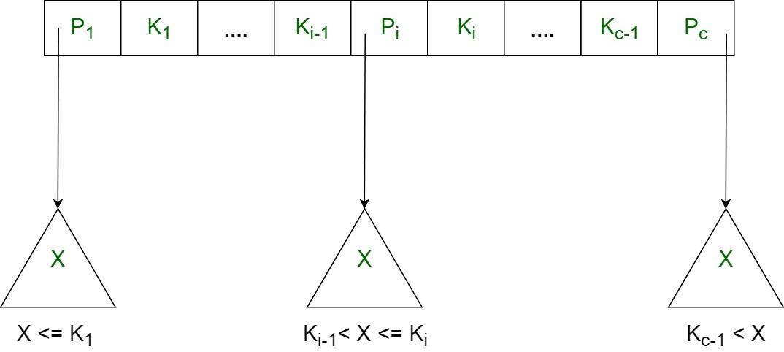
Inner Nodes
In Inner nodes, pointers point to next level nodes
Label the search keys K₁ to K_{n}, and pointers p₁ to p_{n}
Pointer p₁ points to nodes whose search key values are < K₁
Other pointers, p_{i}, point to nodes with search keys ≥ K_{i-1} and < K_{i}
Pointer p_{n} points to nodes whose search key values are ≥ K_{n}
An Inner node must use at least ⎡(n + 1)/2⎤ pointers
 | 12 |  | 24 |  | 29
12 ≤ K < 24
24 ≤ K < 29
K < 12
K ≥ 29
X < K₁
K_{i-1} ≤ X < K_{i}
X ≥ K_{c-1}
Notes:
Insertion and Deletion in B+Tree
•Structure of tree changes to handle row insertion and deletion –no overflow chains
•Tree remains balanced: all paths from root to index entries have same length

Slide 28
Meaning of Inner Node
84
91
key < 84
84 ≤ key < 91
Key >= 91
A B+Tree only stores values in leaf nodes. Inner nodes only guide the search process.

Slide 29
Meaning of Leaf Nodes
63
76
Next leaf
Pointer to record 63
Pointer to record 76

Slide 30
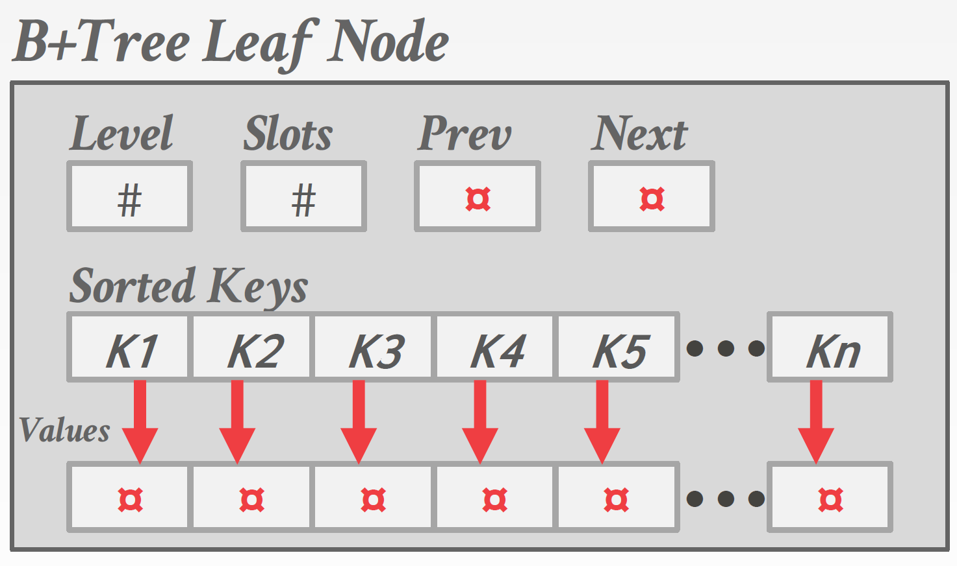
B+Tree Leaf Node
For non-clustered index: Value = Record Id
→ A pointer to the location of the record that the index entry corresponds to.
For clustered index: Value = Record Data
→ The actual record is stored in the leaf node.

Slide 31
B-Trees Space related constraints
Use at least Root: 2 pointers Internal: ⎡(n+1)/2⎤ pointers Leaf: ⎣(n+1)/2⎦ pointers to data

Slide 32
Leaf Nodes
m ≥
(n+1)
⎣
⎦
2
unused
n key slots
k
k
k
…
…
k
1
2
3
m
(n+1) pointer slots
…
…
…
next leaf
record of k
1
record of k
record of k
2
m

Slide 33
Internal Nodes
⎡
(n+1)
⎤
(m+1) ≥
2
unused
n key slots
k
k
k
k
1
2
3
m
(n+1) pointer slots
key < k
1
key >= k
m
k ≤ key < k
1
2

Slide 34
Root Node
(m+1) ≥
2
unused
n key slots
k
k
k
k
1
2
3
m
(n+1) pointer slots
key < k
1
k ≤ key < k
key >= k
1
2
m

Slide 35
Example B Tree
17
in this example n = 3
Each node has at least ⎡(n+1)/2⎤ = 2 pointers.
10
27 |  | 87
2 |  | 5
10 |  | 13 |  | 15
17 |  | 22
27 |  | 35
87 |  | 91
Notes:
We will assume for now that there are no duplicate values for search keys
That is the search key is a candidate key for the relation
The meaning of Inner nodes changes slightly if there are duplicate search key values

Slide 36
Searching a B Tree
The B tree search algorithm
To search for a value K start at the root and end at a leaf
If the node is a leaf and the i^{th} key has the value K then follow the i^{th} pointer to the record
If the node is an Inner node follow the appropriate pointer to the next (Inner or leaf) node
Searching a B tree index requires a number of disk I/O equal to the height of the tree
Plus one I / O to retrieve the record
However the root of the tree may be in main memory
Notes:
is similar to a BST

Slide 37
B Tree Searches
which nodes are visited in a search for 22?
17
which nodes are visited in a search for 16?
10
27 |  | 87
2 |  | 5
10 |  | 13 |  | 15
17 |  | 22
27 |  | 35
87 |  | 91

Slide 38
Range Queries
B trees are useful for processing range queries
A range query typically has a WHERE clause that specifies a range of values
Assume query specifies values from x to y
Search the tree for the leaf that should contain value x
Follow the leaf pointers until a key greater than y is found
The tree can also be used to satisfy queries that have no lower bound or no upper bound

Slide 39
Inserting a Data Entry into a B+ Tree
Find correct leaf L.
Put data entry into L in sorted order.
If L has enough space, done!
Else, must split L and a new node L2
Redistribute entries evenly, copy up middle key (1st value of L2)
Insert a pointer into parent of L pointing to L2
This can happen recursively
To split an Inner node, redistribute entries evenly, but push up middle key.
Splits “grow” tree => tree gets wider
Splits could propagate to root => increasing tree height
Notes:
6
Find correct leaf node L.Put data entry into Lin sorted order.
If Lhas enough space, done!
Otherwise, split Lkeys into Land a new node L2
→Redistribute entries evenly, copy up middle key.
→Insert index entry pointing to L2into parent of L.
To split inner node, redistribute entries evenly, but push up middle key.
root split increases height.
Tree growth: gets wider or one level taller at top.
Insert the record in the in the data file
Retaining the rid and the search key value, K
Insert the entry in the appropriate place in a leaf
Use the search algorithm to find the leaf node
Insert a data entry, if it fits the process is complete
If the target leaf node is full then split it
The first ⎡(n + 1) / 2⎤ entries stay in the original node
Create a new node with the remaining ⎣(n + 1) / 2⎦ entries to the right of the original node
Insert an entry with the first search key value from the new leaf node in the parent node to point to the new node
Adding an entry to an Inner node may cause it to split
The first ⎡(n + 2) / 2⎤ pointers stay in the original node
Create a new node with the remaining ⎣(n + 2) / 2⎦ pointers to the right of the original node
Leave the first ⎡n / 2⎤ keys in the original node and move the last ⎡n / 2⎤ keys to the new node
After inserting a new entry there should be n + 1 keys (and n + 2 pointers)
The remaining key will be a median value between the values in the original and new node
This left over key is inserted into the parent of the node along with a pointer to the new node
Moving a value to a higher, Inner level of the tree, again cause a split
The same process is repeated until no further splits are required, or until a new root node has been created
If a new root is created it will initially have just one key and two children
So will be less than half full
This is permitted for the root (only)
Insert index entry pointing to L2 into parent of L

Slide 40
B Trees Insertion Example
insert 2, 21 and 11
2 |  | 11 |  | 21
the values are maintained in order in the index pages
data file

Slide 41
B Trees Insertion Example
insert 8
11
create new root with the first value of the new leaf node
2 |  | 11 |  | 21
2 |  | 8
11 |  | 21
create a new node with the last ½ of the values
chain the new node to the original node

Slide 42
B Trees Insertion Example
insert 64, then 5
insert 23 ...
11
2 |  | 8
2 |  | 5 |  | 8
11 |  | 21
11 |  | 21 |  | 64
both leaf nodes are now full ...

Slide 43
B Trees Insertion Example
... inserting 23 ...
11
11 |  | 23
2 |  | 5 |  | 8
11 |  | 21 |  | 64
11 |  | 21
23 |  | 64

Slide 44
B Trees Insertion Example
insert 6
11 |  | 23
6 |  | 11 |  | 23
2 |  | 5 |  | 8
2 |  | 5
6 |  | 8
11 |  | 21
23 |  | 64

Slide 45
B Trees Insertion Example
insert 6
6 |  | 11 |  | 23
2 |  | 5 |  | 8
2 |  | 5
6 |  | 8
11 |  | 21
23 |  | 64

Slide 46
B Trees Insertion Example
insert 19 and 9
6 |  | 11 |  | 23
2 |  | 5 |  | 8
2 |  | 5
6 |  | 8
6 |  | 8 |  | 9
11 |  | 21
11 |  | 19 |  | 21
23 |  | 64

Slide 47
B Trees Insertion Example
the same tree ...
6 |  | 11 |  | 23
2 |  | 5
6 |  | 8 |  | 9
11 |  | 19 |  | 21
23 |  | 64

Slide 48
B Trees Insertion Example
insert 7
which will require that it splits
and now insert 8 in the parent
6 |  | 11 |  | 23
2 |  | 5
6 |  | 8 |  | 9
6 |  | 7
8 |  | 9
11 |  | 19 |  | 21
23 |  | 64

Slide 49
B Trees Insertion Example
insert 7 – inserting 8 and a pointer in the root node
and make the middle value the new root
11
keep ½ the pointers and the first ⎡n/2⎤ values
6 |  | 11 |  | 23
move ½ the pointers and the last ⎣n/2⎦ values
6 |  | 8
23
2 |  | 5
6 |  | 7
8 |  | 9
11 |  | 19 |  | 21
23 |  | 64

Slide 50
B Trees Insertion Example
tree after inserting 7
11
6 |  | 8
23
2 |  | 5
6 |  | 7
8 |  | 9
11 |  | 19 |  | 21
23 |  | 64
Notes:
insert values 31, 39, 45, 51, 60, 93

Slide 51
B Trees Insertion Example
insert values 31, 39, 45, 51, 60, 93
11
6 |  | 8
23 |  | 45 |  | 60
2 |  | 5
6 |  | 7
8 |  | 9
11 |  | 19 |  | 21
23 |  | 31 |  | 39
45 |  | 51
60 |  | 64 |  | 93

Slide 52
B Trees Insertion Example
and insert 77
11
6 |  | 8
23 |  | 45 |  | 60
77 |  | 93
2 |  | 5
6 |  | 7
8 |  | 9
11 |  | 19 |  | 21
23 |  | 31 |  | 39
45 |  | 51
60 |  | 64 |  | 93
60 |  | 64

Slide 53
B Trees Insertion Example
... and insert 77 ...
11
now insert 60 in the root
6 |  | 8
23 |  | 45 |  | 60
23 |  | 45
77
77 |  | 93
2 |  | 5
6 |  | 7
8 |  | 9
11 |  | 19 |  | 21
23 |  | 31 |  | 39
45 |  | 51
60 |  | 64

Slide 54
B Trees Insertion Example
... and insert 77 ...
11
11 |  | 60
now insert 60 in the root
6 |  | 8
23 |  | 45
77
77 |  | 93
2 |  | 5
6 |  | 7
8 |  | 9
11 |  | 19 |  | 21
23 |  | 31 |  | 39
45 |  | 51
60 |  | 64

Slide 55
Deleting a Data Entry from a B+ Tree
Start at root, find leaf L where entry belongs.
Remove the entry.
If L is at least half-full, done!
If L has less (n+1)/2 entries,
Try to re-distribute, borrowing from sibling (adjacent node with same parent as L).
If re-distribution fails, merge L and sibling.
If merge occurred, must delete entry (pointing to L or sibling) from parent of L.
Merge could propagate to root, decreasing height.
Notes:
14
Find the entry in the leaf node and delete it
This may result in there being too few entries in the node
If so select an adjacent sibling of the node and
Redistribute values between the two nodes
So that both nodes have enough entries
If this is not possible
Coalesce the two nodes
Delete the appropriate value and pointer in the parent node
When redistribution is not possible, two nodes can be combined (or coalesced if you prefer)
Keep track of the value in the parent between the pointers to the two nodes to be combined
Insert all of the values (and pointers) from one node into the other
Re-connect links between leaves (if the nodes are leaves)
Make a recursive call to the deletion process, deleting the identified value in the parent node
This, in turn, may require non-leaf nodes to be coalesced
A value and pointer are removed from an adjacent sibling and inserted in the node with insufficient entries
The sibling can be the left or the right sibling, although it makes a slight difference to the process
The chosen node must be a sibling to ensure that only a single parent node is affected
After redistribution, one of the two nodes will have a different first search key value
The corresponding value in the parent node must be changed to this value
If the node's sibling(s) have insufficient entries redistribution may not be possible
The deletion algorithm requires a choice to be made between siblings
Such a choice has to be implemented in the algorithm
Coalescing nodes requires more work
It may result in making changes up the tree, but
The tree height may be reduced
Redistributing nodes requires less work, but does not impact the height of the tree
When redistribution is not possible, two nodes can be combined (or coalesced if you prefer)
Keep track of the value in the parent between the pointers to the two nodes to be combined
Insert all of the values (and pointers) from one node into the other
Re-connect links between leaves (if the nodes are leaves)
Make a recursive call to the deletion process, deleting the identified value in the parent node
This, in turn, may require non-leaf nodes to be coalesced

Slide 56
B Trees Deletion Example
delete 19
11
11 |  | 60
6 |  | 8
23 |  | 45
77
77 |  | 93
2 |  | 5
6 |  | 7
8 |  | 9
11 |  | 19 |  | 21
11 |  | 21
23 |  | 31 |  | 39
45 |  | 51
60 |  | 64
use search to find the value
delete the record in the data file first

Slide 57
B Trees Deletion Example
11
11 |  | 60
delete 45
6 |  | 8
23 |  | 45
77
77 |  | 93
2 |  | 5
6 |  | 7
8 |  | 9
11 |  | 21
23 |  | 31 |  | 39
45 |  | 51
51
60 |  | 64
use search to find the value
delete the record in the data file first
the node is less than half full: ⎣(n + 1)/2⎦ pointers to records

Slide 58
B Trees Deletion Example
delete 45
11
11 |  | 60
change the value in the parent node
6 |  | 8
23 |  | 45
23 |  | 39
77
77 |  | 93
2 |  | 5
6 |  | 7
8 |  | 9
11 |  | 21
23 |  | 31 |  | 39
23 |  | 31
51
39 |  | 51
60 |  | 64
take a value from the left sibling node

Slide 59
B Trees Deletion Example
delete 9
11
11 |  | 60
6 |  | 8
23 |  | 39
77
77 |  | 93
2 |  | 5
6 |  | 7
8 |  | 9
11 |  | 21
23 |  | 31
39 |  | 51
60 |  | 64
leaf nodes must use ⎣(n + 1)/2⎦ = 2 pointers
Cannot get keys from a sibling
so must merge the node with its L sibling

Slide 60
B Trees Deletion Example
delete 9
11
11 |  | 60
now delete entry and pointer from parent
6 |  | 8
23 |  | 39
77
77 |  | 93
2 |  | 5
6 |  | 7
6 |  | 7 |  | 8
8 |  | 9
11 |  | 21
23 |  | 31
39 |  | 51
60 |  | 64
leaf nodes must use ⎣(n + 1)/2⎦ = 2 pointers
Cannot get keys from a sibling
so must merge the node with its L sibling

Slide 61
B+ Trees Deletion Example
delete 9
11
11 |  | 60
note that these nodes have enough (2) pointers
now delete entry and pointer from parent
6 |  | 8
6
23 |  | 39
77
77 |  | 93
2 |  | 5
6 |  | 7
6 |  | 7 |  | 8
11 |  | 21
23 |  | 31
39 |  | 51
60 |  | 64

Slide 62
B Trees Deletion Example
delete 6
11
11 |  | 60
the parent entry doesn't need to change
6 |  | 8
6
23 |  | 39
77
77 |  | 93
2 |  | 5
6 |  | 7
6 |  | 7 |  | 8
7 |  | 8
11 |  | 21
23 |  | 31
39 |  | 51
60 |  | 64

Slide 63
B Trees Deletion Example
delete 8
11
11 |  | 60
now delete entry and pointer from parent
6 |  | 8
6
23 |  | 39
77
77 |  | 93
2 |  | 5
2 |  | 5 |  | 7
7 |  | 8
11 |  | 21
23 |  | 31
39 |  | 51
60 |  | 64

Slide 64
B Trees Deletion Example
… delete 8 …
which value?
11
11 |  | 60
so take a pointer from sibling
just 1 pointer
now delete entry and pointer from parent
6
23 |  | 39
77
77 |  | 93
2 |  | 5 |  | 7
11 |  | 21
23 |  | 31
39 |  | 51
60 |  | 64

Slide 65
B Trees Deletion Example
… delete 8 …
which value?
11
11 |  | 60
23 |  | 60
11
23 |  | 39
39
77
77 |  | 93
2 |  | 5 |  | 7
11 |  | 21
23 |  | 31
39 |  | 51
60 |  | 64

Slide 66
B Trees Deletion Example
… delete 8 finished
23 |  | 60
11
39
77
2 |  | 5 |  | 7
11 |  | 21
23 |  | 31
39 |  | 51
60 |  | 64
77 |  | 93

Slide 67
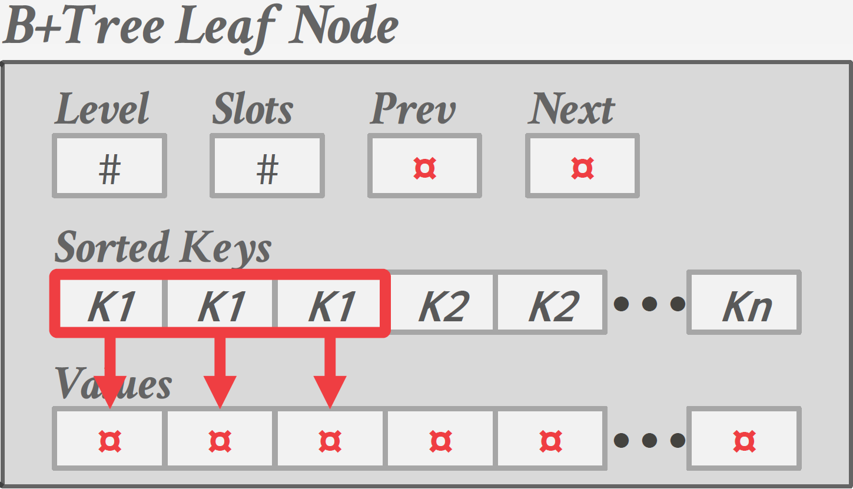
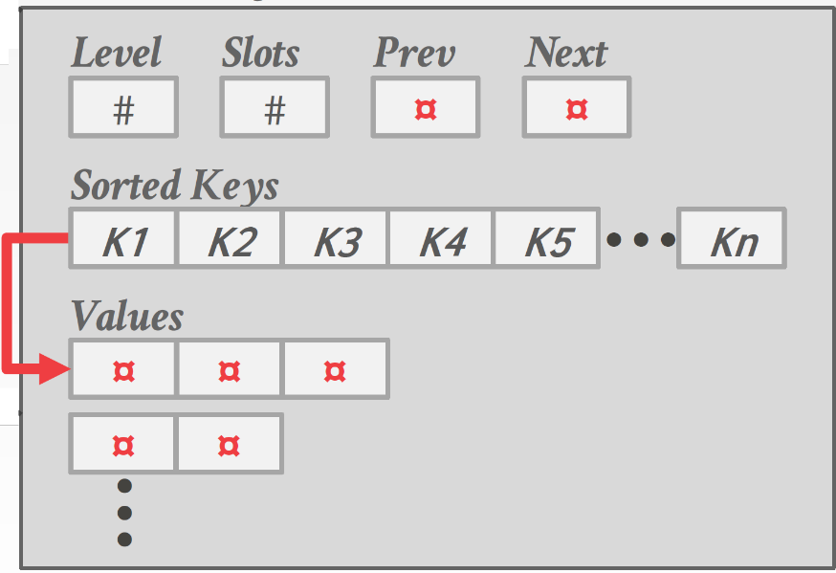
Handling non-unique keys
Approach #1: Duplicate Keys
- Store duplicate keys multiple times.
Approach #2: Value Lists
- Store each key only once and maintain a linked list of values associated with the key

Slide 68
B Tree Height
Assume a block size of 4,096 and the keys are 4 byte integers and pointers are 8 byte addresses
Each tree node can contain 340 key values and pointers
If each node is 2/3 full that is 255 pointers
How many records can be accessed by such a tree with 3 levels?
255³ = 16,600,000 records

Slide 69
B Tree Efficiency
Splitting and merging of index blocks are not frequent
Typically the value of n will be much greater than 3!
Most splits or merges are limited to two leaves and one parent
The number of disk I/Os is based on the tree height
It is a reasonable assumption that the majority of B trees have height of 3
And one level is the root (i.e. one block) which can reside in main memory
Some B tree implementations do not delete Inner nodes
if a leaf has too few keys and pointers it is allowed to remain unchanged
It is assumed that most DB files tend to grow not shrink
Notes:
Some B tree implementations don't fix Inner nodes for deletions
If a leaf has too few keys and pointers it is allowed to remain unchanged
It is assumed that most DB files tend to grow not shrink
It also allows efficient access to records replaced by tombstones in the data file

Slide 70
Key Compression
The height of a tree is determined by the fan-out
The number of children of each node
The fan-out is determined by the number of search key values and pointers that can fit in one page
A smaller search key leads to a greater fan-out and a tree with fewer levels
It may be possible to compress search keys
For example, a search key on last name can be truncated to the extent that it is still sufficient to guide the search

